Slide 1
Computing
Jefferson Lab Users Group Meeting
8 June 2010
Roy Whitney
CIO & CTO

Slide 2
Scientific Computing at JLab
Significant computing capacity for experiments and theory
1400 compute servers
leading edge GPU cluster
(single most powerful dedicated LQCD resource)
growing repository of 6 GeV data
rapidly growing disk capacity and bandwidth,
~ 600 TB disk, half on a 20 Gb/s Infiniband fabric
exploiting & developing leading edge open source tools
Lustre file system, Auger / PBS / Maui batch system, Jasmine storage
Software developments
multi-threading and multi-GPU libraries for high performance computing
LQCD algorithm development, performance optimizations
highly scalable analysis database for LQCD
system management tools
Planning for 12 GeV

Slide 3
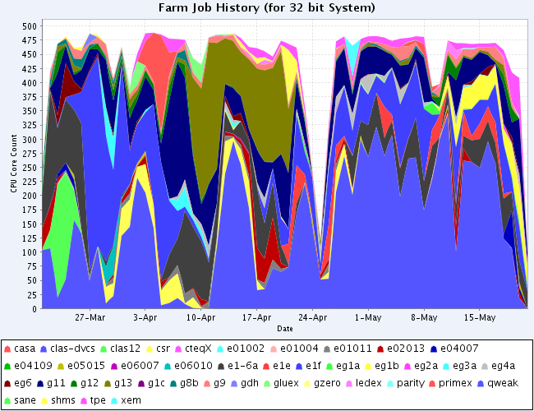
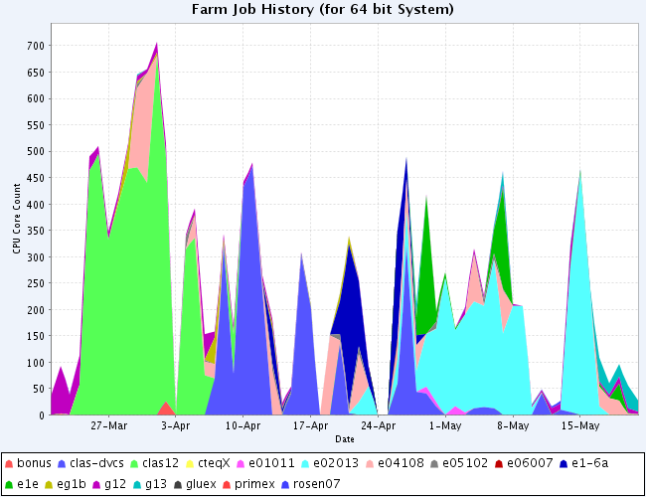
Migrate to 64 bit
32 bit Farm
It is past time!
Just do it!
Over 50% of the JLab 64 bit farm is idle!
64 bit Farm

Slide 4
Scientific Computing – Data Analysis
Batch compute node farm
Auger software system, Maui/PBS
480 (60 x 8) 64-bit cores; 3GB RAM/core; GigE
mostly Intel Nehalems, hyperthreaded
A few AMD systems
240 (120 x 2) 32-bit cores; 0.5GB RAM/core; 100mbit
Half Intel Xeons, hyperthreaded
Half Pentium Ds
Migrate completely to 64-bit computing!
Decommission oldest 32-bit nodes by this fiscal year end: 30 September 2010
Decommission ALL 32-bit nodes by end of calendar year
Run 64-bit native or 32-bit emulation modes

Slide 5
Scientific Computing – Mass Storage
IBM TS3500 Tape Library
8 LTO-4 tape drives; 800GB uncompressed
4 LTO-5 tape drives; 1500GB uncompressed
5500 media slots
Over 4PB stored currently
Still plan to eject oldest unused media
All MSS data still available on tape, through copies to current media at each major technology leap

Slide 6
NP analysis planning and coordination
Physics Division offline analysis is advancing input to scientific computing requirements (contact Graham Heyes):
Gathering requirements estimates from workgroups including comparisons with historical trends and analysis benchmarks
Enhancing communication
Regular meetings of offline coordinators at JLab plus workshops, e.g. CLAS 12
Monitoring of PAC submissions and soon to run experiments
New web presence at data.jlab.org for cross-hall efforts
Plans are under development to assure the long-term viability of the data.
The current computing plan will lead the Lab into the 12 GeV era with computing resources capable of supporting the simulation, calibration, reconstruction and analysis needs in the 12 GeV era.

Slide 7
Science per Dollar for (some) LQCD Capacity Applications
GPUs are a highly cost effective technology
2010 GPU cluster
10²
Optimized LQCD Clusters
?
Mflops / $
A 300 node cluster, optimized to a limited number of science problems, yields a very cost effective platform. GPUs beat that by a factor of ten!
2009
10¹
2007
2006
BlueGene/P
QCDOC
10⁰
2004
USQCD Clusters
2003
BlueGene/L
2002
10⁻¹
QCDSP
Vector Supercomputers, including the Japanese Earth Simulator
Japanese Earth Simulator
10⁻²
Cluster Performance
1990
2000
2010

Slide 8
Computing Support Activities
Helpdesk
Open M-F, 8am – 4:30pm
Desktops – upgrades in process
Windows 7 is the default and suggested version
RedHat EL 5.X is the default and suggested version
Wireless Networks
jlab – for anyone with a CUE account
WPA2 protection
Supports both JLab managed and personal computers
jlab_guest – for anyone without a CUE account
WEP (key available a front desk or help desk)
Personal computers
jlab_secure to be retired this year
All require computer registration
Coverage has been expanded in all major buildings

Slide 9
Computing Support Activities
Telecommunications
Old technology, capacity issues and 12GeV construction
Moving to VoIP
Pilot in FY10
Use existing data network
Deploy with new construction
Cyber Security
Certification & Accreditation in FY10 for new Authority To Operate
Recently performed penetration testing and evaluation of mitigations and controls
No vulnerabilities found on centrally managed machines
All vulnerabilities found and exploited were on user managed machines (guest and level-2)
Patches not up to date, poor configurations
Working on CUE support for Macs

Slide 10
Computing Support Activities
Going Green
Virtual Machines
140 virtual machines on 5 physical machines
Desktop Power Management
750 desktops being managed
Combined, these two actives reduce greenhouse gas emissions by 753,000 lbs per year and save enough energy to power 60 average U.S. homes each year
Evaluating Google Cloud
Calendar and Email

